Slide 1

JAVA/UML PROJECT
PRESENTED BY :
DJONDANG AOUDOU (Chef)
KANAA ALBERT
JODOM MARLENE
TSAGUE DONFACK
SUPERVISED BY :
MR TAWAMBA

Slide 2
ACTION PLAN
INTRODUCTION
PRESENTATION
REALISATION
DEMONSTRATION
CONCLUSION

Slide 3
PROJECT PRESENTATION
CONTEXT
The project about rewriting an old game (1984) Boulder Dash created by Peter Liepa and Chris Gray, about which the principle of the game is to collect a defined number of diamonds to open a passage to the next level. The character, nicknamed Rockford, must dig the earth to make his way. He will have to be careful not to be crushed by a rock or a diamond but also not to make enemies touch.
OBJECTIVES
Rewrite the game
The player have to pick up some objects, especially diamonds to finish the level
Implement the five levels
Manage the player’s displacement/movement

Slide 4

PROBLEMATIC
how can we reproduce the game and respect the requirements?

Slide 5

APPLICATION PRESENTATION
PRESENTATION

Slide 6
UML DIAGRAMS
Class diagrams
Package diagram
Component diagram

Slide 7
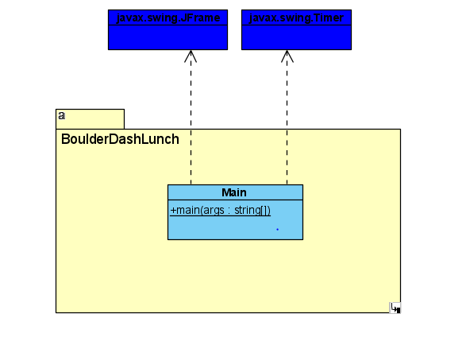
CLASS DIAGRAM
Main

Slide 8
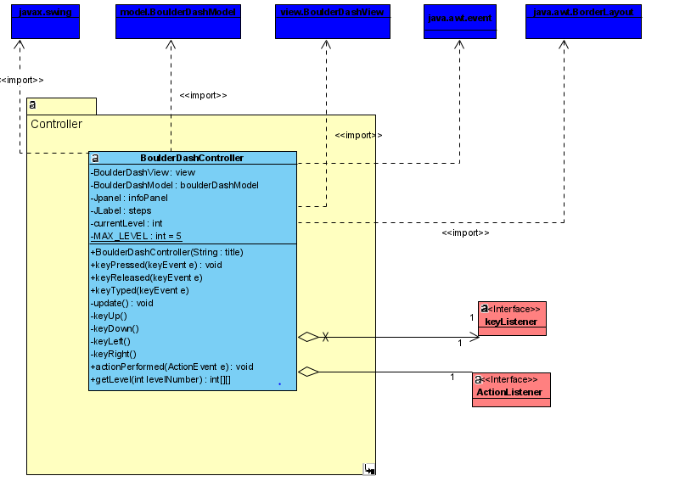
2. Controller

Slide 9
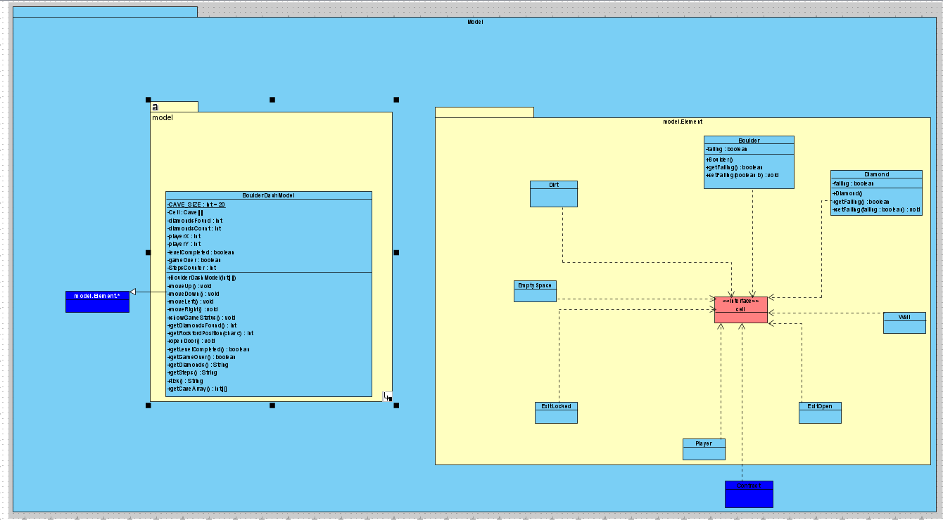
Model

Slide 10
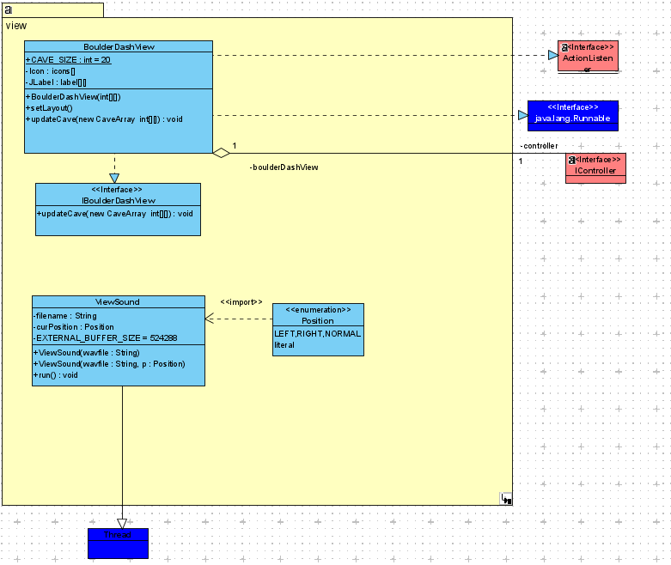
View

Slide 11
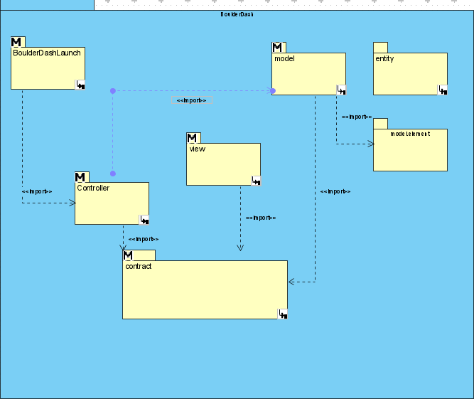
PACKAGE DIAGRAM

Slide 12
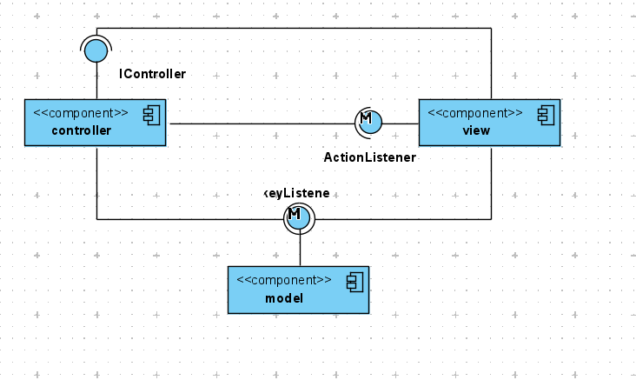
COMPONENT DIAGRAM

Slide 13

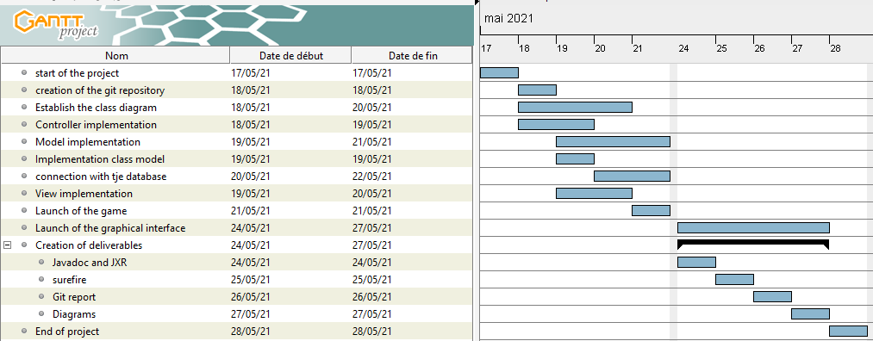
REALISATION
Provisional Planning

Slide 14
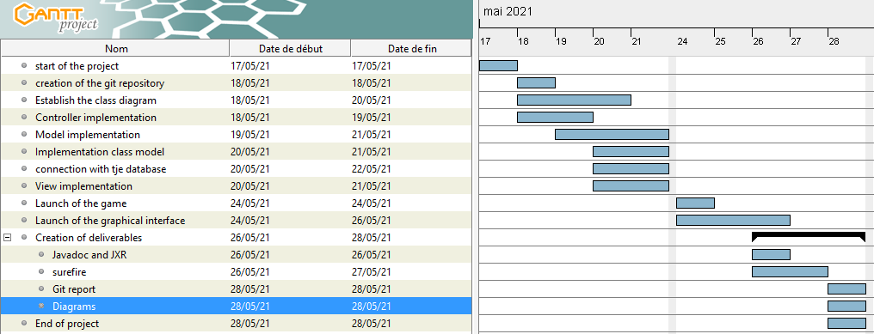
REALISATION
Final and Real Planning

Slide 15
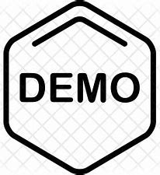

DEMONSTRATION

Slide 16






DESCRIPTION OF THE TOOLS USED
REALISATION

Slide 17
CONCLUSION
This project allowed us to restore all the skills acquired in java. We have tried to meet the requirements imposed by the subject without going any further.

